Slide 1


























EEE2001B Professional Core Computer Organization & Operating Systems (COOS)
1

Slide 2
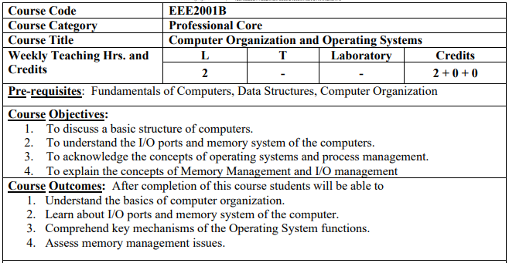

Slide 3
Text and Reference Books
Text Books:
Carl Hamacher, Zvonko Vranesic, Safwat Zaky: Computer Organization, 5th Edition, Tata McGraw Hill, 2002.
Carl Hamacher, Zvonko Vranesic, Safwat Zaky, Naraig Manjikian : Computer Organization and Embedded Systems, 6th Edition, Tata McGraw Hill, 2012.
Reference Books:
William Stallings: Computer Organization & Architecture, 9th Edition, Pearson, 2015.

Slide 4
Unit-1 (Part 1)
Basic Structure of Computers
4

Slide 5
Syllabus Points
Basic operational concepts
Bus structures
Performance – processor clock, basic performance equation, clock rate
Performance measurement
Memory location and addresses
Memory operations
Instructions and instruction sequencing
Addressing modes
Assembly language
Basic input and output operations
Stacks and queues
Subroutines
Additional instructions
Encoding of machine instructions
5

Slide 6
The Computer Revolution
Progress in computer technology
Underpinned by Moore’s Law
Makes novel applications feasible
Computers in automobiles
Cell phones
Human genome project
World Wide Web
Search Engines
Computers are universal
6

Slide 7
Classes of Computers
Desktop/laptop computers
General purpose, variety of software
Subject to cost/performance tradeoff
Workstations
More computing power used in engg. applications, graphics etc.
Enterprise System/ Mainframes
Used for business data processing
Server computers (Low End Range)
Network based
High capacity, performance, reliability
Range from small servers to building sized
Supercomputer (High End Range)
Large scale numerical calculation such as weather forecasting, aircraft
design
Embedded computers
Hidden as components of systems
Stringent power/performance/cost constraints
7

Slide 8
Functional Units
8

Slide 9
Functional Units
I/O
Processor
Input
Arithmetic and logic
Memory
Output
Control
Figure 1.1. Basic functional units of a computer.
9

Slide 10
Information Handled by a Computer
Instructions/machine instructions
Govern the transfer of information within a computer as well as between the computer and its I/O devices
Specify the arithmetic and logic operations performed
Program
Data
Used as operands by the instructions
Source program
Encoded in binary code – 0 and 1
to be

Slide 11
Memory Unit
Store programs and data
Two classes of storage
Primary storage
Fast
Programs must be stored in memory while they are being executed
Large number of semiconductor storage cells
Processed in words
Address
RAM and memory access time
Memory hierarchy – cache, main memory
Secondary storage – larger and cheaper
11

Slide 12
Data Representation
Bit – 1 bit 0 or 1
4 bit = nibble
1Byte – 8 bits
2 byte – 16 bits → 1 word
32 bits → 2 words → double word
64 bit → 4 words → quad word

Slide 13
Arithmetic and Logic Unit (ALU)
Most computer operations are executed in ALU of the processor.
– Load the operands into memory
– bring them to the processor
– perform operation in ALU
– store the result back to memory or retain in the processor.
Registers
Fast control of ALU
13

Slide 14
Control Unit
All computer operations are controlled by the control unit.
The timing signals that govern the I/O transfers are also generated by the control unit.
Control unit is usually distributed throughout the machine instead of standing alone.
Operations of a computer:
Accept information in the form of programs and data through an input unit and store it in the memory
Fetch the information stored in the memory, under program control,
into an ALU, where the information is processed
Output the processed information through an output unit
Control all activities inside the machine through a control unit
14

Slide 15
The operations of a computer
The computer accepts information in the form of programs and data through an input unit and stores it in the memory.
Information stored in the memory is fetched under program control into an arithmetic and logic unit, where it is processed.
Processed information leaves the computer through an output unit.
All activities in the computer are directed by the control unit.
15

Slide 16
Basic Operational
Concepts
16

Slide 17
Review
Activity in a computer is governed by instructions.
To perform a task, an appropriate program consisting of a list of instructions is stored in the memory.
Individual instructions are brought from the memory into the processor, which executes the specified operations.
Data to be used as operands are also stored in the memory.

Slide 18
Instruction:
[Label] : Opcode operand1, operand2
READ A
MOV R0, A
READ B
MOV R1, B
ADD Ro, R1
MOVE C, R0
PRINT C
STOP
START 100

Slide 19
A Typical Instruction
Add LOC A, R0
Add the operand at memory location LOCA to the operand in a register R0 in the processor.
Place the sum into register R0.
The original contents of LOCA are preserved.
The original contents of R0 is overwritten.
Instruction is fetched from the memory into the processor – the operand at LOCA is fetched and added to the contents of R0 – the resulting sum is stored in register R0.
19

Slide 20
Separate Memory Access and ALU Operation
Load LOC A, R1
Add R1, R0
Whose contents will be overwritten?
20

Slide 21
Connection Between the Processor and the Memory
Memory
MAR
MDR
Control
PC
R₀
R₁
R n - 1
IR
Processor
ALU
n- general purpose registers
Connections between the processor and the memory.

Slide 22
Registers
Instruction register (IR)
Program counter (PC)
General-purpose register (R₀ – R_{n-1})
Memory address register (MAR)
Memory data register (MDR)
22

Slide 23
Typical Operating Steps
Programs reside in the memory through input devices
PC is set to point to the first instruction
The contents of PC are transferred to MAR
A Read signal is sent to the memory
The first instruction is read out and loaded into MDR
The contents of MDR are transferred to IR
Decode and execute the instruction
23

Slide 24
Typical Operating Steps (Cont’)
Get operands for ALU
General-purpose register
Memory (address to MAR – Read – MDR to ALU)
Perform operation in ALU
Store the result back
To general-purpose register
To memory (address to MAR, result to MDR – Write)
During the execution, PC is incremented to the next instruction
24

Slide 25
Interrupt
Normal execution of programs may be preempted if some device requires urgent servicing.
The normal execution of the current program must be interrupted – the device raises an interrupt signal.
Interrupt-service routine
Current system information backup and restore (PC, general-purpose registers, control information, specific information)
25

Slide 26
Bus Structures
There are many ways to connect different parts inside a computer together.
A group of lines that serves as a connecting path for several devices is called a bus.
Address/data/control

Slide 27






Bus Structure
Single-bus
Multiple Buses
27

Slide 28
Speed Issue
Different devices have different transfer/operate speed.
If the speed of bus is bounded by the slowest device connected to it, the efficiency will be very low.
How to solve this?
A common approach – use buffers. e.g.- Printing the characters
28

Slide 29
Performance
29

Slide 30
Performance
The most important measure of a computer is how quickly it can execute programs.
Three factors affect performance:
Hardware design
Instruction set
Compiler
30

Slide 31
Performance
Processor time to execute a program depends on the hardware
involved in the execution of individual machine instructions.
Main memory
Cache memory
Processor
Bus
Figure 1.5. The processor cache.
31

Slide 32
Performance
The processor and a relatively small cache
memory can be fabricated integrated circuit chip.
Speed
Cost
Memory management
on a single
32

Slide 33
Processor Clock
Clock, clock cycle (P), and clock rate (R=1/P)
The execution of each instruction is divided into several steps (Basic Steps), each of which completes in one clock cycle.
Hertz – cycles per second
33

Slide 34
Basic Performance Equation
T – processor time required to execute a program that has been
prepared in high-level language
N – number of actual machine language instructions needed to complete the execution (note: loop)
S – average number of basic steps needed to execute one machine instruction. Each step completes in one clock cycle
R – clock rate
Note: these are not independent to each other
_{T =} N × S
R
How to improve T?
Reduce N and S, Increase R, but these affect one another
34

Slide 35
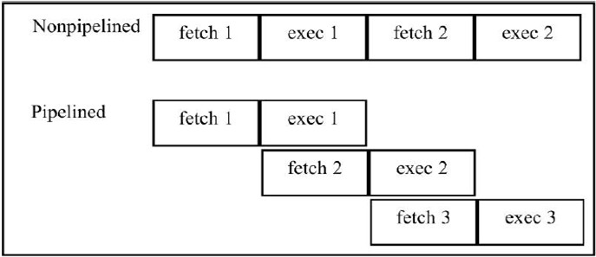
Pipeline and Superscalar Operation
Instructions are not necessarily executed one after another.
The value of S doesn’t have to be the number of clock cycles
to execute one instruction.
Pipelining – overlapping the execution of successive instructions.
Add R1, R2, R3 at the same time processor reads next
instruction in memory.

Slide 36
1 clk cyle per phase
2 = Fetch and execute
3 instruction
NP = No. of instruction * no. of phases = 3*2 = 6 clk cycle
Pipelines = 1 Instruction * 2 +(2) remaining instruction*1
= 1 * 2 + 2
= 4

Slide 37
Pipeline and Superscalar Operation
Superscalar operation – multiple instruction pipelines are implemented in the processor.
Goal – reduce S (could become <1!)

Slide 38
Clock Rate
Increase clock rate
Improve the integrated-circuit (IC) technology to make the circuits faster
Reduce the amount of processing done in one basic step (however, this may increase the number of basic steps needed)
Increases in R that are entirely caused by improvements in IC technology affect all aspects of the processor’s operation equally except the time to access the main memory.
38

Slide 39
Compiler
A compiler translates a high-level language program into a sequence of machine instructions.
To reduce N, we need a suitable machine instruction set and a compiler that makes good use of it.
Goal – reduce N×S
A compiler may not be designed for a specific processor; however, a high-quality compiler is usually designed for, and with, a specific processor.

Slide 40
Performance Measurement
T is difficult to compute.
Measure computer performance using benchmark programs.
System Performance Evaluation Corporation (SPEC) selects and publishes representative application programs for different application domains, together with test results for many commercially available computers.
Compile and run (no simulation)
Reference computer
_{SPEC rating =} Running time on the referencecomputer Running time on the computer under test
n
1
SPEC rating = (∏ SPEC_{i} ) ^{n}
i=1
n is the number of program in the suite

Slide 41
Multiprocessors and Multicomputers
Multiprocessor computer
Execute a number of different application tasks in parallel
Execute subtasks of a single large task in parallel
All processors have access to all of the memory – shared-memory multiprocessor
Cost – processors, memory units, complex interconnection networks
Multicomputers
Each computer only have access to its own memory
Exchange message via a communication network – message-
passing multicomputers

